Slide 1
Evaluation Methods
Design & Manufacture

Slide 2
Evaluation Methods
It is very important to choose the correct method of evaluating your chosen product, and there are many ways to do so...
Product Review
Surveys & Questionnaires
Focus Groups
Test Rigs
Comparing products

Slide 3
Product review.... This is when you would look at a product and pick out all of it’s good and bad features. This helps to determine how a product can be improved by keeping the good bits and changing the bad bits.

Slide 5
Surveys/ Questionnaires...This is when you would ask a range of people a variety of questions about an existing product. This helps to understand the public’s perceptions of the product and can help designers improve the product in the future. Often these questions are basic YES/NO answers so that they can be analysed easily...
The questions usually come from the products Identifying Factors.
Function Do you think that the product does what it is supposed to do well/easily?
Ergonomics Is the product comfortable/easy to use?
Durability Does the product look like it will last for a long time/short time?
Safety Does the product look like it would be safe to use?
Cost How much would you be willing to pay for this product if you were to buy it?
Aesthetics Do you think that the product looks appealing to the buyer?

Slide 6
Surveys/ Questionnaires
Once the surveys/questionnaires have been completed the answers are analysed and put into tables and charts so that the designers can see at a glance what the market (people that will potentially buy the product) thinks of the product and what can be changed/kept to improve the product for the future.

Slide 7
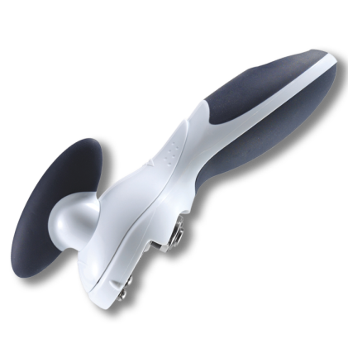
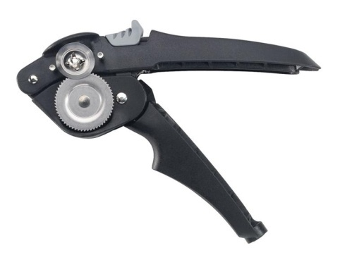
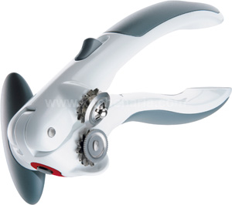
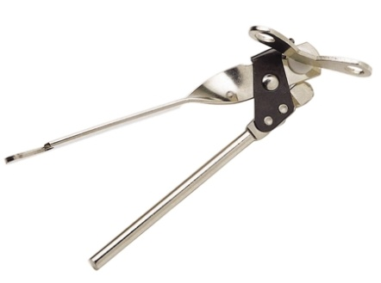
Surveys/ Questionnaires Example
A group of 100 people were asked...
Q1. Which of these tin openers looked easiest to use?
Q2. Which of these tin openers would you buy on looks alone?
A
B
C
D

Slide 8
The results were then analysed and tallied off on a Table of Results and then put into a Graph to show the best tin opener.
Table of results Q1.
Number of people Tin Opener | 5 | 10 | 15 | 20 | 25 | 30 | 35 | 40 | 45
A
B
C
D
Table of results Q2.
Number of people Tin Opener | 5 | 10 | 15 | 20 | 25 | 30 | 35 | 40 | 45
A
B
C
D

Slide 9
Results Graph
By looking at the graph you can clearly see that Tin Opener B is the best from the questions asked.
No. of people
Tin opener

Slide 10
Focus Groups
A Focus Group is when a group of people are asked about their perceptions, opinions, beliefs, and attitudes towards a product. You can ask the same YES/NO questions that were asked in the questionnaire but then ask the group WHY they thought YES or NO. It is through asking “why” that designers can really understand what it is that the consumer is wanting in a product.
WHAT do you think about this.....?
HOW do you think this could be better.....?
WHY do you think this.....?
WHO do you think would buy this product.....?

Slide 11
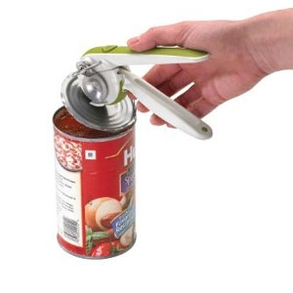
Product Testing/Test Rigs/User Trials
Product testing or asking someone to complete a test rig/user trial can also be used to evaluate an existing product. The person would test the product/use it for its required purpose (e.g. open a tin with a tin opener, dry their hair with a hairdryer etc) and as they are using the product they would comment on what they think of the product. This helps the designers understand how a person is thinking when they are using the product and what they want when using a product.
They would again comment on
things such as:
Function
Ergonomics
Durability
Safety
Aesthetics
Materials

Slide 12
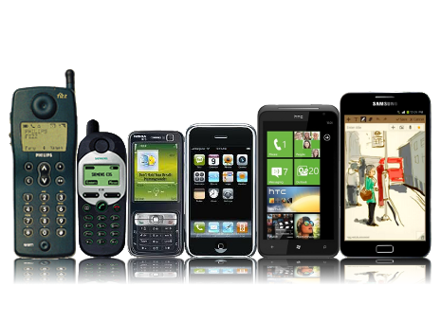
Comparing products
It is important to compare Similar products with each other. By doing so, a designer can take all of the good design features from many different items and put them into one SUPER product. Similarly the designer can see what bad features the different products have and avoid doing the same things within their design.
As well as comparing similar products together, designers also compare dissimilar products together. Designers take inspiration from other products and integrate things from one product to another. For instance think about the mobile phone from years ago compared to now.... What other products do you think designers could have looked into to create mobiles from today?

Slide 13
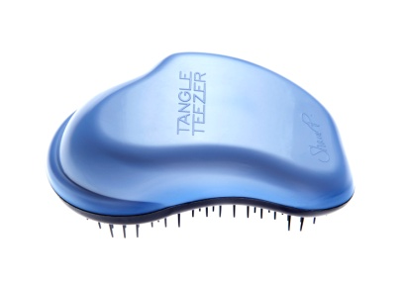
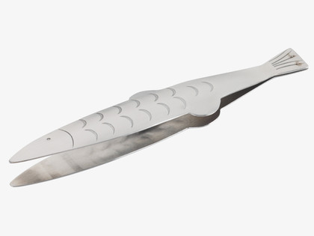
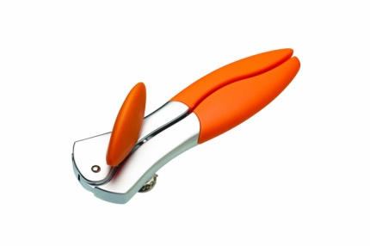
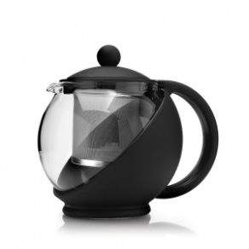
Your Task
Your task is to decide on one of these methods of evaluating a product and use it to evaluate your own chosen product.
The easiest option would be to make up a questionnaire or survey and hand it out to the rest of the class....
Or
Make up some questions and do a mini Focus Group with members of the class... You may make notes on what is said to help you remember the peoples’ thoughts on the questions asked which will help you when you write your report later.

Slide 14
Your Task
We will take the next class to come up with the questions that you will use for your questionnaire/survey/focus group, and then another 1-2 classes to collect your data (individual task).
Once you have your data you will be putting it into some form of Report with your findings from your questionnaire/survey/focus group. This can be done on the computer or written by hand.... Please note that if this is not finished in the class time given you will be required to finish the report as Homework... If you do not have access to a computer at home it is probably better that you do your report by hand.

